Slide 1
Deadlock Prevention and Avoidance
Chapter 6
Last Updated 9/28/2017 12:39 PM

Slide 2
What is Deadlock?
The permanent blocking of a set of threads or processes that are competing for a common set of system resources.
A set of processes is deadlocked when every process in the set is blocked awaiting an event that can only be triggered by a blocked process in the same set.
Deadlock is permanent because every process is blocked and unable to produce the event needed by another process in the set to proceed.
Most often deadlock is caused when processes are blocked by a request for a resource held by another process in the set.

Slide 3
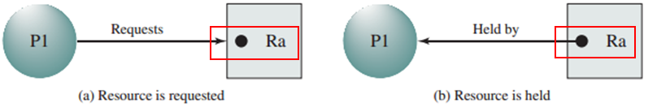
Resource Allocation Graph
A method of illustrating resource allocation …
A process that is making a request to own a resource.
A process currently owns i.e. has exclusive access to a resource.
Dots indicate the number of instances of the resource the system has made available.
Notes:
A dot that does not an arrow extending from it is not currently allocated.

Slide 4
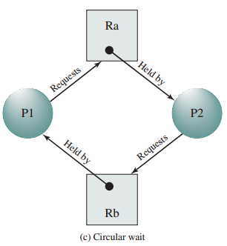
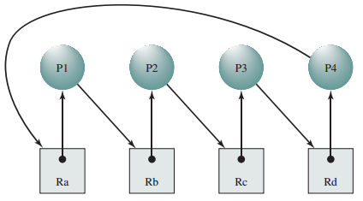
Deadlock in a Resource Allocation Graph
The left graph indicates that all instances of required resources Ra and Rb are held by two processes in the set.
With a circular dependency between owning/requesting processes.

Slide 5
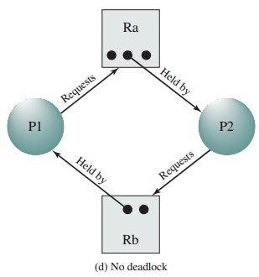
No Deadlock Here
In this graph, there exists sufficient resources to supply processes P1 & P2’s requirements.
Would deadlock exist with only a single instance of Rb?
Notes:
No, because P1 holds its needed instance of Rb and there is > 1 Ra.

Slide 6
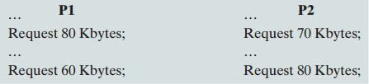
What is a Resource?
A Resource…
Can be allocated to (owned) by at most a single process.
Can be allocated to a different process when released.
Examples include Memory, Devices, Files, Semaphores & others.
Example of memory as a deadlock resource:
The system maintain a total of 200 Kbytes of memory.
Notes:
After the first request, there is not enough memory to fulfill either process’s second request.
Is a semaphore a resource? While not a permanent resource like a file or device, once a semaphore is created it can be own, released, and owned by a different process.

Slide 7
Deadlock Among Communicating Processes
Communicating processes that block for received messages can also enter into deadlock.
P1 and P2 block waiting to receive a message from the other before sending their message.
In practical terms, an actual deadlock scenario may be far more subtle and involve several processes.
But in any case, there will be a set of dependencies that form a cycle between the processes in the deadlock.
Notes:
Executing from top-down, each process is blocked waiting to receive a message that will not be sent by the other process in the deadlock cycle.

Slide 8
The Conditions for Deadlock
There are four conditions that must hold for a deadlock to exist.
Mutual Exclusion: Only a single process can hold a resource while other requesting processes are blocked while waiting.
Hold & Wait: A process will hold allocated resources while also blocked waiting for other requested resources to be allocated.
No Preemption: A process cannot be asked to release the resources it holds.
Circular Dependency: There exist a set of blocked processes where each process: 1) Holds a resources needed by another process in the set. 2) Requires a resource held by another process in the set.

Slide 9
Addressing Deadlocks
Can we avoid or eliminate deadlocks from our systems?
Mutual Exclusion is an important principle for the safe execution of concurrent threads and processes.
Mutual exclusion is needed to build Critical Sections to protected against Race Conditions.
Relaxing the second or third condition requires processes that allow resources to be released after they are allocated.
The ability to ‘rollback’ a process’s to its state before it allocated any of the resources it holds i.e. roll back either process execution as shown in the progress diagrams earlier.
This ‘rollback’ is hard, if not impossible, in most general cases.
Notes:
An exception to the no-rollback are transactions in DBMS.

Slide 10
Three Strategies for Addressing Deadlocks
Deadlock Prevention: Prevent deadlocks by adopting policies that exclude the possibility of one of the four deadlock conditions.
Deadlock Avoidance: Monitor the state of the system and actively guide process execution away from conditions that may result in deadlock.
Not covering in this section.
Deadlock Detection: Detect the existence of a deadlock in the system and take actions to recover i.e. break the deadlock.
Notes:
Most of the following techniques are largely academic exercises (i.e. with much practical application), but some techniques can be applied to special cases such as database management systems (DBMS).

Slide 11
Deadlock Prevention Techniques
Design the system / program in such a way that the possibility of deadlock is impossible.
This might accomplished by preventing the occurrence of one of the four conditions.
Mutual Exclusion can not be prevented i.e. it must be supported.
Mutual Exclusion is needed to build Critical Sections and safe multi-threaded applications free of race conditions.

Slide 12
Deadlock Prevention (Hold & Wait)
Hold & Wait can be prevented by:
Requiring every process declare all of its needed resources before execution starts.
Delay starting the execution of a process until all its resources are available and has be allocated to the process.
Preventing Hold and Wait is problematic because:
A process may be waiting for a long time for all of its resources.
A very inefficient use of resources. A process may need the resources for a relatively short amount of time compared to its overall execution.
It is difficult for a process to declare the resources it needs before execution starts i.e. it is impossible to predict the amount of memory needed or files that will need to be locked.

Slide 13
Deadlock Prevention (No Preemption)
No Preemption can be addressed by allowing preemption.
By requiring a process, who’s resource request cannot be fulfilled, to release all the resources it currently holds.
When process (P1) requests a resource currently held by another process (P2), the operating system forces P2 to release the resource (maybe because P1 is of a higher priority than P2).
Works if the process’s state can be saved when making a resource request and restored if the resources is released.
Difficult (impossible) to accomplish in general, but work for DBMS.
A reliable method of releasing a process’s resources is to kill the process.
Notes:
Restarting a state is impossible in the general programming case because a process will / might have modified memory or files whose original (pre-allocation) state cannot be recovered.

Slide 14
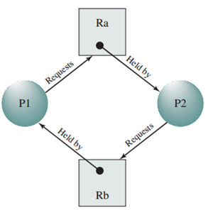
Deadlock Prevention (Circular Wait)
Circular Wait can be prevented by ordering the allocation of resources.
Apply an ordering to resources Ra, Rb, Rc, etc.
Each process must request and be allocated resources in this order.
All process must request and get access to Ra before requesting Rb, before Rc etc. i.e. Ra > Rb > Rc …
The deadlock shown above would be impossible.
P1 & P2 would have both requested Ra before Rb.
Only one process would gain Ra and other would be blocked.
Notes:
This approach allows processes to start their execution before all of their resources can be allocated avoiding the poor resource utilization that occurs with earlier DL avoidance techniques.
The resource allocation priority may be explicitly coded into the system / application by the developer.
One example is the bank account numbers from the debit account example. If the debit operations lock accounts in ascending (or descending) order, then two debit operations will never enter into a deadlock state.

Slide 15
Deadlock Prevention measures are difficult to implement.
Generally, a process cannot declare the resources it will need before its execution starts.
Allocating all of a process’s resources for the duration of it’s execution is an inefficient use of those resources.
Often a process’s resource requirements is short-term i.e. memory or I/O devices are used for brief periods of execution.
The start of a process’s execution should not delayed waiting for resources that are needed until far into its execution.
Generally, programs cannot release its locked resources i.e. to roll-back its state to some previous check-point.

Slide 16
Effectiveness of Deadlock Prevention
While they guarantee the elimination of deadlocks, these techniques are overly restrictive, are often impossible to implement, and result in the inefficient use of resources.
This is especially true when considering that most unsafe allocations very rarely result in a deadlock.
The practical likelihood of a deadlock is usually very small.
An unfortunate alignment of resource allocations and requests that are not likely to occur.
On the other hand, identifying the processes (threads) involved in a deadlock when one occurs can be difficult.

Slide 17
Deadlock Detection
Deadlock Detection strategies rely on detecting deadlocks when they occur and taking action to break the cycle.
Act only if the a dependency cycle in the currently blocked processes is detected.
Java and other language systems provide tools that can automate the identification of the threads and shared resources involved in a deadlock.
Java’s Profiler is one such tool.

Slide 18
Deadlock Recovery: How to address the situation where a deadlock exists?
What can be done to correct the situation of two or more deadlocked processes?
If possible, release allocated resources until the deadlock is broken. This is usually not possible.
Use a Database Management System to implement the service. Database transactions can be ‘rolled back’ to a checkpoint.
Successively kill processes until the deadlock is broken.
Options 3 requires a means of quantifying and selecting the process that will have the least negative impact on the system when it is terminated.

Slide 19
Kill-Process Selection Criteria
These are just a few of the criteria that may be used to determine which process in the deadlock set to kill.
The amount of processor time i.e. the amount of time spent in a running state.
The number of allocated resources.
The amount of I/O i.e. the number of I/O requests or the number of bytes transferred.
The amount of estimated time remaining (assuming that such an estimate is available).
The process’s priority as assigned by the operating system.
Again, we are interested in identifying the process that will cause the least damage to the system when terminated.

Slide 20
Programming Tips
Always keep the amount of time that resources are locked as short as possible.
Minimize the number of statements executed in a critical section.
Avoid making I/O requests or other blocking system calls inside critical sections.
Lock & unlock objects in the same region / block of code.
Avoid locking resources in different methods / code blocks as this makes it difficult to see where the circular dependencies arise.
Acquire locks in the same order in separate threads.
That is, Resource Ordering Deadlock Prevention

Slide 21
Programming Tips
To help with identifying deadlocks some language systems (e.g. Java) provide a means of generating a “Thread Dump”
Writes the state of all threads in the VM (including the thread’s state and object the thread is blocked on) to a file that can be read and analyzed by a profiler or debugging tool.
Java Profiler tools have the capability to detect the threads involved in a deadlock, but detection is not automatic.
DBMS are able to automatically detect and can roll-back transactions involved in a deadlock.

Slide 22
The Dining Philosophers Problem
The Dining Philosophers is a classic study in mutual exclusion and deadlock prevention.
There are seats for N philosophers at a round table.
Each philosopher enters the room, eats, and leaves.
When a philosopher begins to eat, they pickup (lock) the two forks on either side of their seat.
If the fork (resource) is held by an adjacent philosopher, the requesting philosopher waits until the fork is released.
When finished eating, they return (release) their forks to the table.
How can a deadlock occur?
Notes:
Deadlock occurs when every philosopher starts eating at the same time and each picks up their left (or right) fork simultaneously.

Slide 23
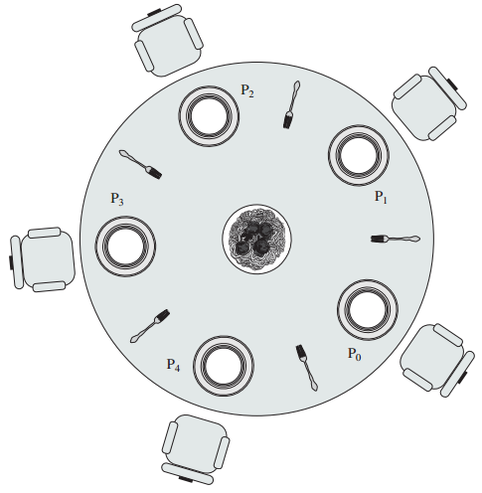
The Philosophers Table

Slide 24
Solution to Dining Philosophers
We need a solution that both prevents deadlock and doesn’t starve any one philosopher.
The book offers two solutions:
Using Semaphores
Using Monitors
Notes:
The specifics of the solution is given as an assessment question and not presented here.

